Slide 1
CHAPTER 10 Memory Components, Forgetting, and Strategies
记忆成分、遗忘和策略

Slide 2
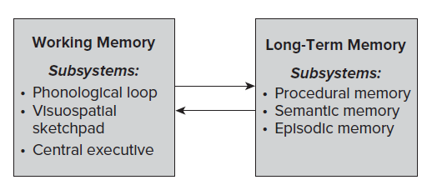
P231 FIGURE 10.1 A schematic diagram of the working memory and long-term memory systems with the subsystems identified for each. The arrows represent the interactive nature of the two systems. 工作记忆和长期记忆系统示意图及其它们的子系统。 箭头表示两个系统的交互性质。
工作记忆
工作记忆
子系统
子系统
程序记忆（过程）
语义（短期存储）
语义记忆
空间（短期存储）
事件记忆
长期记忆找回的信息（调配整合）

Slide 3
P232 A CLOSER LOOK①
Pitching in Baseball: A Demonstration of the Interactive Workspace Function of Working Memory
棒球投球：工作记忆的交互式工作区功能的演示
The situation. You are a baseball catcher or coach who needs to decide which pitch the pitcher should throw next. To make this decision, you must consider information about both the present situation and past experiences. In terms of the present situation you need to consider who the batter is, the score, who and where the runners on base are, the number of outs, the locations of defensive players in the infield and outfield, the ball and strike count, and so on. In terms of past experiences you need to consider the batter’s batting history in similar situations, the opposing team’s tendencies in this situation—especially if they have runners on base—the pitcher’s history of pitch-ing in similar situations, and so on.
场景:您是一名棒球接球手或教练，需要决定投手接下来要投哪个球。 要做出此决定，您必须考虑有关当前状况和过去经验的信息。 就目前的情况而言，您需要考虑击球手，得分，垒手是谁在哪里，出局次数，内场和外场防守球员的位置，球和击球得分等。 根据过去的经验，您需要考虑击球手在类似情况下的击球历史，在这种情况下对方球队的倾向（尤其是如果他们有垒手），投手在类似情况下的投手历史等等。

Slide 4
P232 A CLOSER LOOK②
Pitching in Baseball: A Demonstration of the Interactive Workspace Function of Working Memory
棒球投球：工作记忆的交互式工作区功能的演示
Working memory involvement. The working mem-ory serves as a temporary workspace to enable you to integrate the information about the present situation and past experiences so that you can select the best pitch for right now. After receiving your pitch choice, the pitcher will involve the working memory to retrieve from long-term memory the invariant charac-teristics of the type of pitch required and then use the temporary workspace to apply specific movement- related features to the pitch, such as speed and loca-tion. After the pitch is delivered, the information in working memory is deleted to provide space for new information to allow the pitcher to respond to what the batter does or to throw the next pitch you select.
工作记忆的参与。 工作记忆用作临时工作区，使您能够集成有关当前状况和过去经验的信息，以便您可以立即选择最佳的投球。 在收到投球选择指令之后，投手将使用工作记忆从长期记忆中检索所需投球类型的不变特征，然后使用临时工作区将与运动相关的具体特征应用于投球，例如速度和位置。 传递投球特征后，工作记忆中的信息将被删除，给新信息提供空间，使投手能够响应击球手的动作或扔出选择的下一个投球。

Slide 5
P233 A CLOSER LOOK①
Experimental Procedures to Assess the Duration of Movement Information in Working Memory
工作记忆中评价运动信息持续时间的实验程序
The classic experiment by Adams and Dijkstra (1966) set the standard for the procedural protocol researchers have used to investigate the question concerning the duration of movement information in working memory. Because the researchers were interested in movement information, their procedures were designed to require participants to use only proprioceptive information to perform the task.
Apparatus. An arm-positioning apparatus con-sisted of an almost friction-free handle that could be moved left or right along a metal trackway. This apparatus sat on a table facing the participant in the experiment.
Adams和Dijkstra（1966）进行的经典实验为研究人员用来研究有关工作记忆中运动信息持续时间的程序规程设定了标准。 因为研究人员对运动信息感兴趣，所以他们的程序设计为要求受试者仅使用本体感受信息来执行任务。
仪器：手臂定位仪由一个几乎无摩擦的手柄组成，它可以沿着金属轨道向左或向右移动。 该仪器放置在面对实验受试者的桌子上。

Slide 6
P233 A CLOSER LOOK②
Experimental Procedures to Assess the Duration of Movement Information in Working Memory
工作记忆中评价运动信息持续时间的实验程序（评估工作记忆中动作信息持续时间的实验步骤）
Task. To begin a trial, a blindfolded participant moved the handle of the apparatus along the track-way to a location specified by a physical block(the criterion arm position to be remembered). After returning the handle to the starting point and waiting for a certain amount of time (the retention interval), the participant performed a recall test by moving the handle to his or her estimate of the arm position just experienced (the physical block had been removed). The experimenter recorded the location and the participant returned the handle to begin a new trial, which involved moving to a new position along the trackway.
任务：开始一次试验指被戴上眼罩的受试者将一起（仪器）的手柄沿着轨道移动到由物理块（有点奇怪？物块可么？）指定的位置（要记住的标准手臂的位置）。将手柄放回到起点并等待一定的时间（即保持间隔（保持时间间隔））后，受试者通过将手柄移至他或她对刚经历的估计（受试者凭借记忆将手柄移动至她或他印象中刚才）的手臂位置来执行保持测试（进行回忆测试）（已移除物理障碍物/物块已被移除）。 实验人员记录下这个位置，受试者将手柄放回原处以开始新的试验，该试验涉及沿轨道移动到新的位置（新试验需要沿着轨道移动到新的位置）。

Slide 7
P233 A CLOSER LOOK③
Experimental Procedures to Assess the Duration of Movement Information in Working Memory
工作记忆中评价运动信息持续时间的实验程序
Determining duration. To determine the length of time movement location information stayed in work-ing memory, the researchers compared various dura-tions of the retention interval. They determined the accuracy of the participants‘ recall movements for each retention interval length. Duration of the mem-ory for the arm position was assumed to be related to the degree of accuracy of the recall movement. As you can see in figure 10.2 below, arm-positioning recall accuracy decreased (i.e., error increased) very sharply for retention intervals up to 20 sec, and continued to decrease for longer interval lengths.
确定持续时间。 为了确定运动位置信息在工作记忆中停留的时间长度，研究人员比较了不同的保持间隔时间。 他们确定了每个保持间隔时间的受试者回忆动作的准确性。 假定手臂位置的记忆保持时间与对动作的回忆准确度有关。 正如您在下面的图10.2中所看到的那样，在长达20秒的保持间隔内，手臂定位的保持时间准确度急剧下降（即误差增加），而且在更长的间隔时间内持续下降。

Slide 8
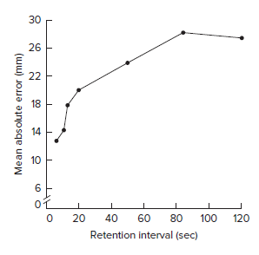
P233 A CLOSER LOOK④
Experimental Procedures to Assess the Duration of Movement Information in Working Memory
工作记忆中评价运动信息持续时间的实验程序
FIGURE 10.2 Results from the experiment by Adams and Dijkstra showing the mean absolute error for the recall of an arm-positioning task following different lengths of retention intervals. [From Adams, J. A., & Dijkstra, S. (1966). Short-term memory for motor responses. Journal of Experimental Psychology, 71, 314-318.]
图10.2 Adams和Dijkstra的实验结果显示了在不同的保持间隔时间后，对手臂定位任务的平均绝对误差为。 [摘自Adams，J. A.和Dijkstra，S.（1966）。 短期记忆，用于运动反应。 实验心理学杂志，71，314-318。]
平均绝对误差（毫米）
保持间隔（秒）

Slide 9
P235 A CLOSER LOOK①
The Influence of Emotion on Memory of an Event: Recalling Details of Two Yankees versus Red Sox Championship Games
情绪对事件记忆的影响：回顾两次洋基队与红袜队冠军赛的细节
A study by Breslin and Safer (2011) presented an inter esting approach to providing evidence that posi-tive and negative emotionally arousing experiences are recalled more accurately than experiences where neither emotion is involved. More than 1,500 baseball fans who reported having attended, watched, or read about the 2003 and 2004 American League Cham-pionship games between the New York Yankees and Boston Red Sox (a well-known rivalry even when no championship is at stake) were asked to complete a questionnaire about each game. The participants were identified as Yankee fans, Red Sox fans, or neutral in their support for either team.
Breslin and Safer（2011）的一项研究提出了一种有趣的方法，该方法可以证明积极和消极的情绪出现比不涉及任何情绪的出现更能被准确地召回。 超过1500名棒球迷被问到是否曾参加、观看或阅读过纽约洋基队和波士顿红袜队之间的2003年和2004年美式冠军杯赛（即使没有冠军头衔，这也是众所周知的竞争） 并完成有关每个比赛的问卷调查。 受试者被认为是洋基队的球迷、红袜队的球迷或中立的球迷。

Slide 10
P235 A CLOSER LOOK②
The Influence of Emotion on Memory of an Event: Recalling Details of Two Yankees versus Red Sox Championship Games
情绪对事件记忆的影响：回顾两次洋基队与红袜队冠军赛的细节
Method and questionnaires: Prior to answering the questionnaires about the games, the participants were each reminded that the Yankees won the 2003 game and the Red Sox won the 2004 game. The ques-tionnaires asked participants to recognize and recall details about the two games and to rate their own sub-jective memories about the games. The items of inter-est to the researchers, which were identical on each questionnaire, asked:
What was the final score of each game?
Who were the winning and losing pitchers for each game? (a multiple-choice list)
What was the location of each game (New York or Boston)?
Did the game require extra innings?
方法和调查表：在回答有关比赛的调查表之前，每个受试者都被提醒美国洋基队赢得了2003年比赛，红袜队赢得了2004年比赛。 问卷要求受试者识别和回忆有关这两个比赛的详细信息，并对自己对游戏的主观记忆进行评分。 研究人员感兴趣的项目在每个调查表上都相同，问题：
每场比赛的最终得分是多少？
每场比赛的输球手是谁？ （多项选择列表）
每场比赛（纽约或波士顿）的位置在哪里？
比赛需要额外的局数吗？

Slide 11
P235 A CLOSER LOOK③
The Influence of Emotion on Memory of an Event: Recalling Details of Two Yankees versus Red Sox Championship Games
情绪对事件记忆的影响：回顾两次洋基队与红袜队冠军赛的细节
Results: The following were the main results of this study:
The correct responses to the questions showed similar accuracy for all the participants.
Accuracy was higher for the fans that supported one of the teams than for the neutral fans.
Yankees fans recalled more details accurately for the game the Yankees won.
Red Sox fans recalled more details accurately for the game the Red Sox won.
Fans reported remembering the game their team won more vividly than the game their team lost.
Fans reported thinking about the game their team won since the time of the game.
Conclusion: Consistent with research of autobio-graphical memories, most individuals relive and recall more often and vividly memories that are posi-tive rather than negative.
结果：以下是本研究的主要结果：
对于所有参与者，对问题的正确回答显示出相似的准确性。
支持一支球队的球迷的准确性比中立球迷更高。
洋基队球迷准确地回忆了洋基队获胜比赛的更多细节。
红袜队球迷准确地回忆了红袜队赢得比赛的更多细节。
球迷们报告说他们的球队赢得的比赛比他们的球队输掉的比赛更为生动。
球迷们报告说自从比赛开始以来，他们的球队就赢得了比赛。
结论：与自传体记忆的研究一致，大多数人更生动地回忆和想起积极而不是消极的记忆内容。

Slide 12
P239 A CLOSER LOOK①
Typical Explicit Memory Test Paradigms Used in Experiments to Assess Remembering and Forgetting
实验中用于评估记忆和遗忘的典型外显记忆测试范例
Researchers who investigate the causes of forgetting and remembering typically use procedures that follow three basic paradigms, depending on whether they are interested in the effects of time or activity. These paradigms are illustrated below from the participant’s point of view in terms of the events that take place at specific times during the experiment.
研究遗忘和记忆原因的研究人员通常使用遵循以下三种基本范例的程序，具体取决于他们是否对时间或活动的影响因素感兴趣。 下面以受试者的角度在实验过程中特定时间发生的事件说明这些范例。

Slide 13
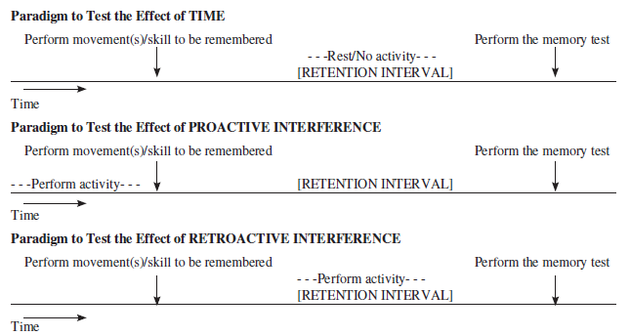
P239 A CLOSER LOOK②
Typical Explicit Memory Test Paradigms Used in Experiments to Assess Remembering and Forgetting实验中用于评估记忆和遗忘的典型外显记忆测试范例
对时间影响进行测试的范式
休息/不活动[保持间隔]
操作需要被记住的动作和技能
进行记忆测试
时间
对前摄抑制的影响进行测试的范式
[保持间隔]
操作需要被记住的动作和技能
进行记忆测试
时间
对后摄抑制的影响进行测试的范式
活动[保持间隔]
操作需要被记住的动作和技能
进行记忆测试
时间

Slide 14
P242 A CLOSER LOOK①
Proactive Interference Influences Gymnastics Judging 前摄抑制会影响体操评价
A series of studies by Diane Ste-Marie and her colleagues provide interesting evidence that gymnastic judges’ evaluations of a gymnast’s performance may be influenced by their having watched the gymnasts during pre-competition warm-up sessions. In each study, the following procedures were used:
Participants: Female gymnastics judges certified by Gymnastics Canada
Study phase: The judges watched videotapes of individual gymnastic elements performed by several gymnasts. The elements were edited parts of actual routines the gymnasts performed. The judges evalu-ated the performance of each as perfect or with a form error.
Test phase: The judges watched and evaluated the same gymnasts performing elements that were:
1.the same way as in the study phase;
2.a different way from in the study phase, i.e., with an error if perfect in study phase, or vice versa;
3.a new element, which was not in the study phase.
Diane Ste-Marie和她的同事进行的一系列研究提供了有趣的证据，说明体操裁判对体操运动员表现的评价可能会受到他们在赛前热身赛期间观看体操运动员表现的影响。 在每项研究中，均使用了以下程序：
受试者：加拿大体操认证的女子体操裁判
研究阶段：裁判观看了几名体操运动员表演的单个体操元素的录像带。 这些片段是由体操运动员执行的实际表演编辑而成。 评委们对每项表现的评价为完美或有一个形式的错误。
测试阶段：法官观看并评估了与体操运动员相同的操作片段：
1.与研究阶段相同的方式（SAME）；
2.与研究阶段不同的方式，即在研究阶段完善时出错，反之亦然（DIFFERENT）；
3.一个不在研究阶段出现过的的新片段（NEW）。

Slide 15
P242 A CLOSER LOOK②
Proactive Interference Influences Gymnastics Judging 前摄抑制会影响体操评价
Results of each study:
Ste-Marie and Lee (1991) showed the following order of judgment accuracy percentages for the three test-phase conditions:Highest judging accuracy: When the elements seen in the test phase were the same as those in the study phase Highest: SAME;Next highest judging accuracy: When the ele-ments seen in the test phase were newLowest judging accuracy: When the elements seen in the test phase were performed in a different way than they were in the study phase
This order of test accuracy demonstrates that observ-ing and evaluating the performance of previously seen elements biased the judges’ evaluations when the elements were performed differently from the previous observation. This bias is seen in the results that show lower judgment accuracy for elements the judges had seen previously, but that were per-formed differently, than for elements they had not seen previously. Interestingly, the bias occurred even though the judges were not consciously aware that they had seen the elements they evaluated in the same/different test conditions performed in the study phase.
每个研究的结果：
Ste-Marie和Lee（1991）对三个测试阶段条件给出了以下的判断准确度百分比顺序：最高判断准确度：当在测试阶段看到的片段与研究阶段中的片段相同时最高（SAME）;下一个最高的判断准确性：在测试阶段看到的片段是新的时（NEW）；最低的判断准确性：当在测试阶段看到的片段以与研究阶段不同的方式执行时（DIFFERENT）
测试准确性的这一顺序表明，当观察到的片段与先前观察到的结果不同时，观察和评估先前观察到的片段的表现会使裁判的评估产生偏差。从结果中可以看出这种偏见，这些结果表明裁判员对以前看到过但表演方式不同的片段的判断准确性较低。有趣的是，即使法官没有意识到他们已经在研究阶段相同/不同测试条件下看到了所评估的片段，仍然存在偏差。

Slide 16
P242 A CLOSER LOOK③
Proactive Interference Influences Gymnastics Judging 前摄抑制会影响体操评价
∙Ste-Marie and Valiquette (1996) showed the same order of accuracy as the Ste-Marie and Lee study when the test phase occurred immediately, one day, or one week after the study phases. These results indicate that the bias effects of previous observations persisted for at least one week.
∙Ste-Marie, Valiquette, and Taylor (2001) showed the same order of test accuracy as the previous two studies when the study phase involved judging the performance of each element, naming the ele-ment performed, or naming the apparatus involved. These results indicate that the test accuracy results in the previous studies were due to watching the gymnasts perform during the study phase and not to the judges being involved in evaluating the per-formance of each element.
These studies provide excellent demonstrations of the influence of proactive interference on human mem-ory, especially when the previous experiences involve characteristics that are similar to those involved in the test situation.
∙Ste-Marie和Valiquette（1996）指出，在研究阶段之后即刻、一天或一周之后进行的测试阶段，显示出与Ste-Marie和Lee研究相同的准确性。 这些结果表明，先前观察产生的偏见至少持续了一个星期。
∙Ste-Marie，Valiquette和Taylor（2001）在研究阶段涉及判断每个片段的表现，给表演的片段命名或指定所用的器材时，显示出的与前两项研究相同的测试准确性顺序。 这些结果表明先前研究中的测试准确性结果是由于观察体操运动员在研究阶段的表现，而不是因为裁判员参与了评估每个片段的表现。
这些研究很好地证明了前摄抑制对人类记忆的影响，特别是当以前的经验所涉及的特征与测试情况所涉及的特征相似时。

Slide 17
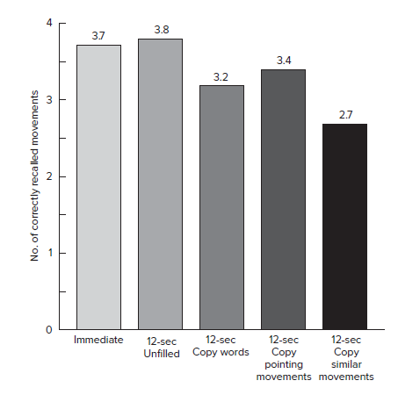
P243 FIGURE 10.3
Free recall results of the experiment by Smyth and Pendleton showing the retroactive interference effects of perfor-mance of similar movements to those that had to be remembered. [From Smyth, M. M., & Pendleton, L. R. (1990). Space and movement in working memory. Quarterly Journal of Experimental Psychology, 42A, 291–304.]
史密斯（Smyth）和彭德尔顿（Pendleton）的实验的自由回忆结果显示，后摄抑制对那些记忆动作类似动作的影响。 [摘自Smyth，M. M.和Pendleton，L. R.（1990）。 工作记忆中的空间和运动。 实验心理学季刊，42A，291–304。]
正确动作回忆的数量
12秒模仿类似动作
12秒模仿指定动作
12秒词汇抄写
即刻
12秒无任务间隔

Slide 18
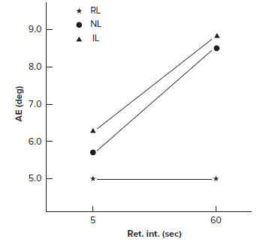
P247 FIGURE 10.5
相关标签
无标签
不相关标签
Mean absolute error computed across posi-tions for the 5-sec and 60-sec retention intervals (ret. int.) in Experiment 1 by Shea. (RL = relevant label, NL = no label, IL = irrelevant label.) [From Shea, J. B. (1977). Effects of labeling on motor short-term memory. Journal of Experimental Psychology: Human Learning and Memory, 3, 92–99.]
Shea在实验1中针对5秒和60秒保持间隔（ret.int。）时的不同位置计算出的平均绝对误差。 （RL =相关标签，NL =无标签，IL =不相关标签。）[摘自Shea，J. B.（1977）。 标签对电机短期记忆的影响。 实验心理学杂志：人类的学习与记忆，3，92–99。]
绝对误差（度）
保持间隔（秒）

Slide 19
P249 A CLOSER LOOK①
Active and Passive Limb Movements: Evidence for the Application of the Encoding Specificity Principle to Motor Skills
主动和被动肢体运动：将编码特异性原理应用于运动技能的证据
An excellent example of research evidence supporting the application of the encoding specificity principle to the remembering of movements is an experiment done many years ago by Lee and Hirota (1980).
Apparatus. An arm-positioning apparatus on a table facing the participant.
Task and experimental conditions. On some trials, blindfolded participants actively moved the handle of the apparatus along the trackway to a criterion arm position that was specified by a physical block. On other trials, they were pas-sively moved by the experimenter to a criterion arm position. For the recall test on each trial, participants were told to actively move to the arm position just experienced or were passively moved by the experimenter until the participant told the experimenter to stop. This procedure continued until all participants had actively and passively experienced the presentation of each criterion arm position and had performed recall tests in either the same way they had experienced the presenta-tion of the criterion position or the opposite way.
Lee和Hirota（1980年）进行的一项实验很好地证明了可以使用编码特异性原理应用于运动记忆。
仪器：面向参与者的桌子上的手臂定位仪器。
任务和实验环境：在一些试验中，戴着眼罩的受试者将设备的手柄沿轨道主动移动到由物理块指定的标准手臂位置。在其他试验中，实验者将它们平稳地移动到标准手臂位置。在每次试验的回忆测试中，受试者被告知要主动移至刚经历过的手臂的位置，或者被动的被主试者移动到受试者要求停下为止。此过程一直持续到所有受试者都主动和被动地经历了每个标准手臂位置的演示，并以与经历过标准位置的演示相同或相反的方式执行了回忆测试。

Slide 20
P249 A CLOSER LOOK②
Active and Passive Limb Movements: Evidence for the Application of the Encoding Specificity Principle to Motor Skills
主动和被动肢体运动：将编码特异性原理应用于运动技能的证据
Encoding specificity principle predictions.
Active movements to the criterion arm move-ments should be recalled better when the movements are actively recalled than passively recalled.
Passive movements to the criterion arm move-ments should be recalled better when the move-ments are passively recalled than when they are actively recalled.
Results. As you can see in figure 10.6 below, the results supported the encoding specificity prin-ciple. When the movement during the recall test was performed in the same way as it was during the presentation of the criterion arm position (i.e., active-active, passive-passive), recall perfor- mance was more accurate than when the recall test was performed differently from the way it was during the presentation of the criterion arm posi-tion (i.e., active-assive, passive-active).
Note that there was no advantage to recalling active rather than passive movements. The dif-ference in recall accuracy is more related to the relationship between the presentation and recall conditions.
编码特异性原理预测
当主动回忆动作而不是被动回忆时，对于主动移动到标准手臂位置的动作回忆成绩应该更好。
当被动回忆动作而不是主动回忆时，对于被动移动到标准手臂位置的动作回忆成绩应该更好。
结果 如下面的图10.6所示，结果支持编码特异性原理。当执行回忆测试期间的运动与演示标准手臂位置时（即主动-主动，被动-被动）的方式相同时，回忆效果比执行回忆测试时的准确性更高不同于标准手臂位置的表示方式（即主动-主动，被动-主动）。
请注意对被动作进行主动回忆没有任何好处。回忆准确性的差异与展示和回忆环境之间的关系更为相关。

Slide 21
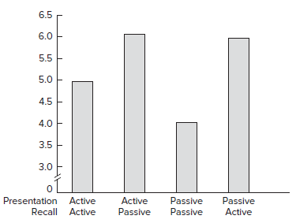
P249 A CLOSER LOOK③
Active and Passive Limb Movements: Evidence for the Application of the Encoding Specificity Principle to Motor Skills
主动和被动肢体运动：将编码特异性原理应用于运动技能的证据
FIGURE 10.6 Results of the experiment by Lee and Hirota showing absolute error for recalling arm-position movements presented as either active or passive and recalled in either the same or opposite conditions. [From data in Lee, T. D., & Hirota, T. T. (1980). Encoding spec- ificity principle in motor short-term memory. Journal of Motor Behavior, 12, 63–67.]
图10.6 Lee和Hirota的实验结果表明，在相同或相反的条件下回忆起主动或被动呈现的手臂位置运动的绝对误差。 [摘自Lee，T. D.和Hirota，T. T.（1980）中的数据。 电机短期记忆中的编码规范原理。 运动行为杂志，12，63–67。]
被动主动
主动被动
被动被动
主动主动
展示回忆
展示回忆

